Slide 1
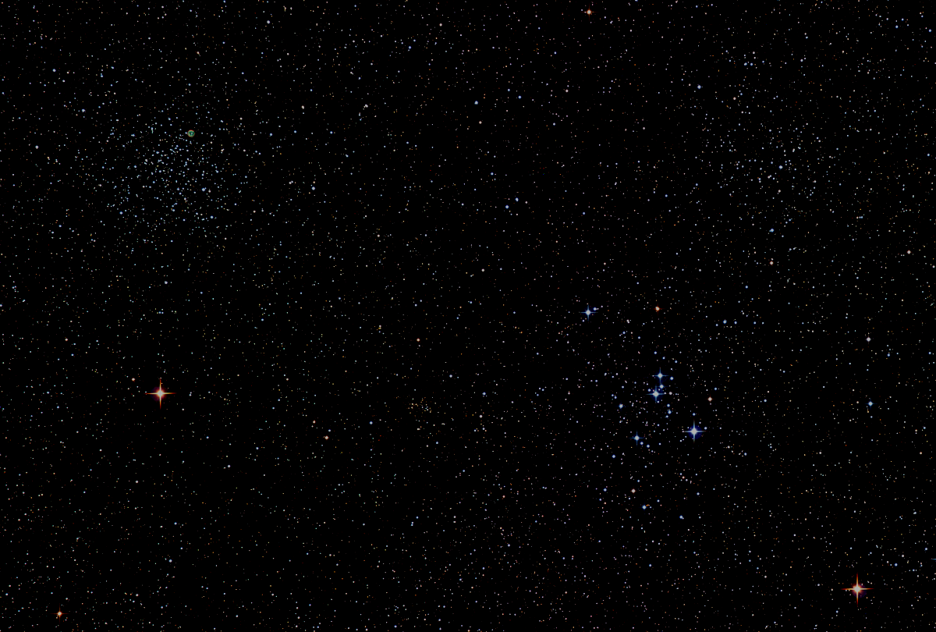

Howard
Astronomical
League
17
May 18th, 2017

Slide 2
Introductions

Slide 3
HAL Social Media
Website:
http://www.howardastro.org
Facebook:
https://www.facebook.com/groups/howardastro/
Yahoo Group (mailing list):
https://tech.groups.yahoo.com/group/howardastro/
Notes:
Mention the HAL Yahoo group has over 400 members, and the Facebook group has 282 members. Obviously, not all of those folks are HAL members, but they are all astronomy enthusiasts

Slide 4
Upcoming Events
HAL Events
May 20th at 8pm– Members’ Star Party, Alpha Ridge
June 3rd at 8:30pm – Public Star Party, Alpha Ridge
Regional Events
May 21-28 – Texas Star Party
May 24-28 – York County, PA Star Party
June 22-25 – Cherry Springs, PA Star Party

Slide 5
Guest Speaker
Mr. Lou Mayo
NASA Goddard Space Flight Center
Program Mgr for 2017 Eclipse Education
Eclipse 2017: Through the Eyes of NASA
Notes:
Lou Mayo is a planetary astronomer at the NASA Goddard Space Flight Center. Lou Mayo with over 20 years experience in program management, supporting NASA and NOAA, including over 10 years managing efforts for the NASA National Space Science Data Center and the Space Physics Data Facility. He has over 20 years experience in planetary research working on special problems concerning planetary atmospheres. He served for 11 years on the Voyager IRIS and Cassini CIRS teams. He has over 15 years experience developing and implementing space science education programs on both regional and national levels and is a professor of astronomy at Marymount University and member of the DC Space Grant Consortium. He has authored numerous articles on astronomy and astronomy education and is a frequent speaker on space science and astronomy for the public. He is presently Program Manager for NASA's 2017 Eclipse Science Education Program and Heliophysics Education Consortium and professor of astronomy at Marymount University.

Slide 6
Member’s astrophotos
and sketches

Slide 7
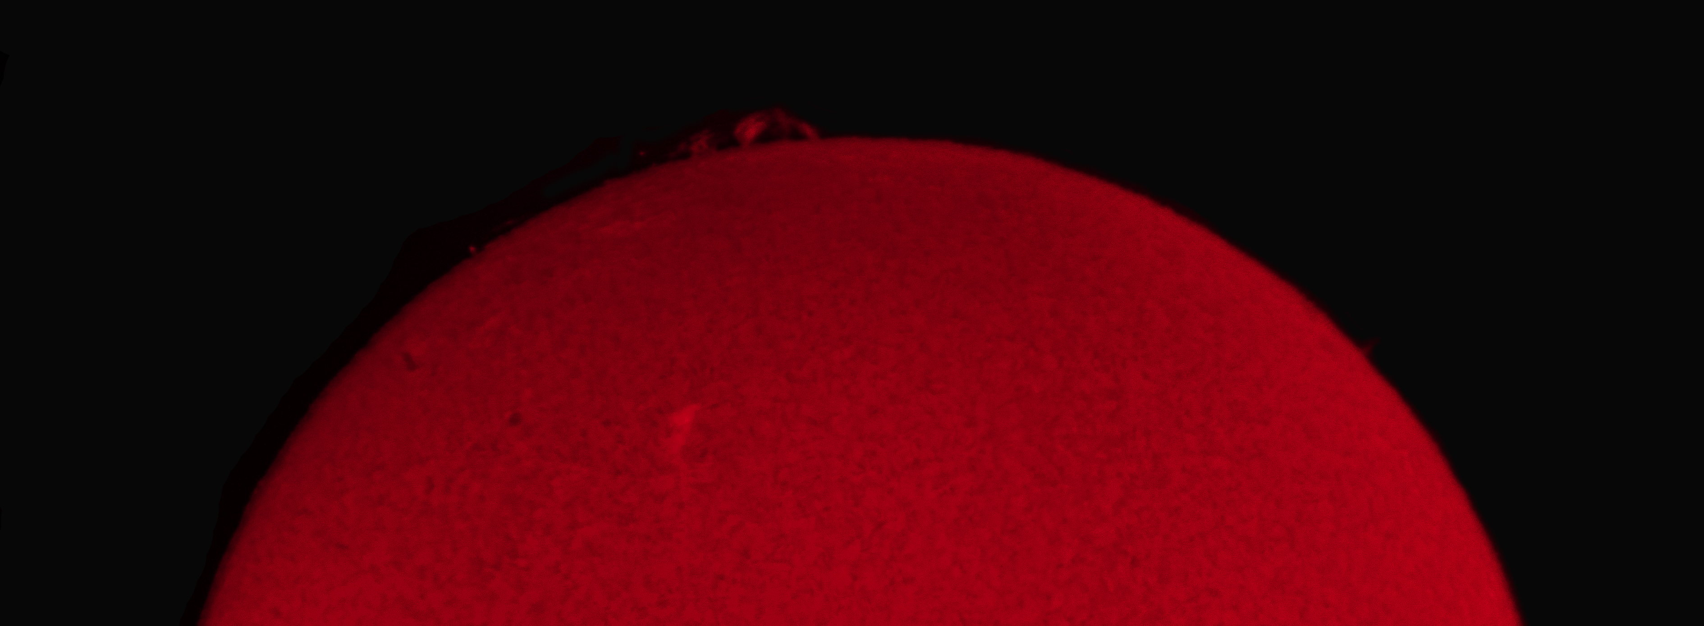
Nice Prominence on the Sun
Richard Orr
Notes:
Chuck Cynamon – First deep sky photo!
Kitt Peak overnight observing program on Oct 30, 2016
This is NGC 7479 (aka C44). Light was collected by 10” GSO on an astrophysics 1200 mount (located in Durango, CO). The weather condition in Tucson were cloudy and windy and thus preventing us from using the 20” reflector as we had planned. My Instructor, Dean Salman, had me remotely control one of his two scopes in CO. We used a QSI 583 CCD to collect 600 second LRGB exposures which we were stacked using CCD stack to produce this image.

Slide 8
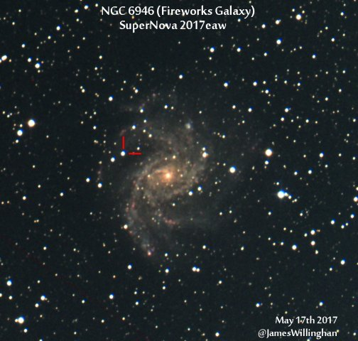

Slide 9
Night Sky Summary
Sun now rises at 5:52am and sets at 8:17pm
Moon: |◐ May 18|⚪May 25|◑ June 1|⚫ June 9| Best earthshine view is around May 28.
Planets: Venus continues its morning apparition, rising just before the beginning of twilight, and reaching greatest elongation on June 3rd. Find Mars continuing to hang on in the western sky after sunset. It will be lost in the twilight by next month’s meeting. Jupiter Is very favorably placed for evening viewing, but is slowly decreasing in apparent size and losing a bit of its luster. Look for a nice double shadow transit on May 25th. Saturn rises in the late evening, headed toward opposition on June 14th. Its rings are tipped near their widest opening this month, making the Cassini division an easier target for small scopes.

Slide 10
Thank You!
Next month’s meeting is on Thursday, June 15th, 2017 at 7 PM
Guest Speaker /Topic TBD

